Slide 1

Credit Card Fraud Detection

Slide 2
Outline
Introduction
Fraud detection
Dataset
Software & Libraries
Algorithms
Output
Observations
Conclusions
Future scope

Slide 3
Introduction
Credit card:- It is a small plastic card issued by a bank and used for online transactions.
Fraud:- Criminal deception intended to result in financial or personal gain.
Credit card fraud:- It is a fraud committed using a payment card.
The purpose may be to obtain goods or services etc.
Inner card fraud:- Done by using false identity.
Outer card fraud:-Done by using stolen credit card.

Slide 4
How Frauds are recognized?
Frequency: Make a large number of transactions in short period of time.
Amount: Suddenly if the costly items are purchased.
Items you buy: If you deviate from your regular buying pattern or time.

Slide 5
Credit Card Fraud Detection
Supervised: Models are estimated based on samples of fraudulent or valid transactions to classify new transactions as fraud or valid.
Unsupervised: The outliers transactions are considered as potential instance of fraud.

Slide 6
Dataset
This dataset have 492 frauds out of 284,807 transactions means 0.172% fraud cases.
The dataset is highly unbalanced.
It contains only numerical input variables which are the result of a PCA transformation.
Due to confidentiality issues, we cannot provide the original features and more background information about the data.
Features V1, V2, … V28 are the principal components obtained with PCA.
'Time' and 'Amount’ are not transformed with PCA.
Time :- The seconds elapsed between each transaction and the first transaction in the dataset.
Amount:- It is the transaction Amount.
Class:- The response variable and it takes value 1 in case of fraud and 0 otherwise.

Slide 7
Software & Libraries
python 3.4.7(Jupyter notebook)
numpy
pandas
seaborn
scipy
Sklearn
Matplotlib

Slide 8
Algorithms
Appropriate algorithms are
Isolation Forest
Local Outlier Factor
These algorithms are used to find the outliers in the dataset with better accuracy.

Slide 9
Isolation Forest:
This is an algorithm with a low linear time complexity and a small memory requirement.
It builds a good performing model with a small number of trees using small sub-samples of fixed size, regardless of the size of a data set.
The Isolation Forest algorithm isolates observations by randomly selecting a feature and then randomly selecting a split value between the maximum and minimum values of the selected feature.
Isolating anomaly observations is easier because only a few conditions are needed to separate those cases from the normal observations.
Isolating normal observations require more conditions.
Therefore, an anomaly score can be calculated as the number of conditions required to separate a given observation.

Slide 10
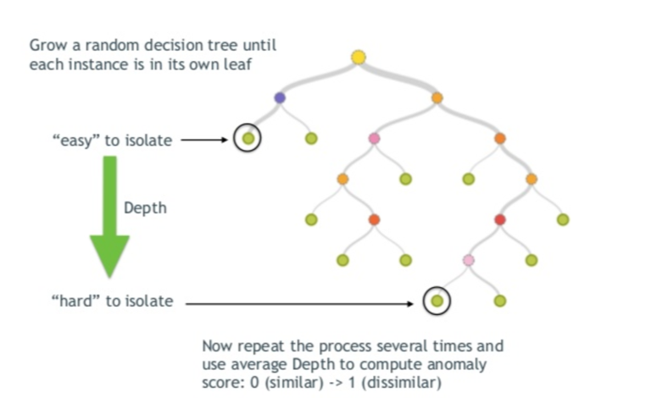
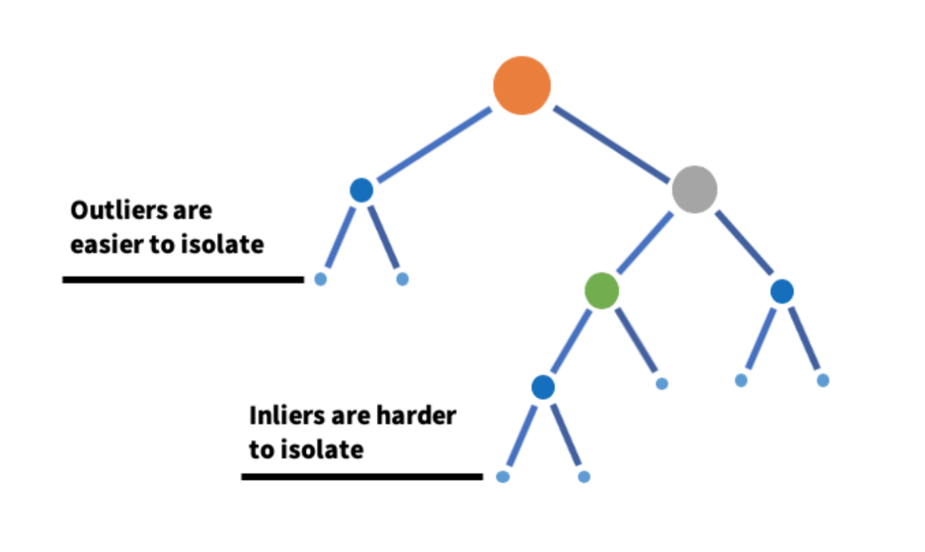
Contd..…
This algorithm helps to isolate outliers

Slide 11
Local Outlier Factor:
This algorithm is an unsupervised outlier detection method which computes the local density deviation of a given data point with respect to its neighbors.
It considers as outlier samples that have a substantially lower density than their neighbors.
The number of neighbors considered, (parameter n_neighbors) is typically chosen
1) greater than the minimum number of objects a cluster has to contain, so that other objects can be local outliers relative to this cluster
2) smaller than the maximum number of close by objects that can potentially be local outliers. In practice, such informations are generally not available, and taking n_neighbors=20 appears to work well in general.

Slide 12
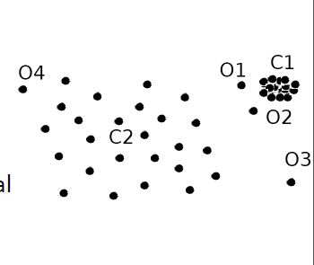
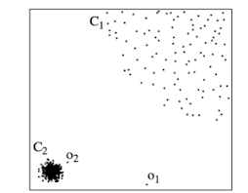
Contd…..
Indication of ‘o’ - {o1,o2,o3,o4} are outliers

Slide 13
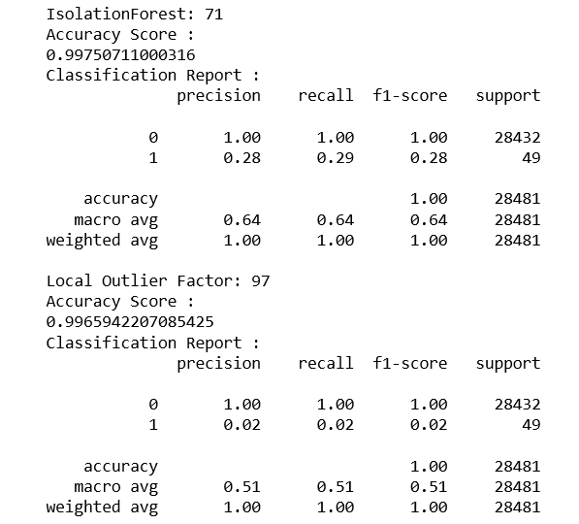
Output
Accuracy : 99.75%
Accuracy : 99.65%

Slide 14
Observations:
Isolation Forest detected 71 errors and 99.75% accuracy.
Local Outlier Factor detected 97 errors and 99.65%accuracy.
When comparing error precision & recall for 2 models , the Isolation Forest performed much better than the LOF.
The detection of fraud cases is around 27% vs LOF detection of just 2%
So overall Isolation Forest Method performed much better in determining the fraud cases which is around 30%.

Slide 15
Conclusion
We can also improve on this accuracy by increasing the sample size or use deep learning algorithms however at the cost of computational expense.
We can also use complex anomaly detection models to get better accuracy in determining more fraudulent cases

Slide 16
Future Scope
After detecting the fraudulent transaction, it has to be notify the customer.
For a fraudulent cases, the user get notified via receiving the mail or message for the registered account number.

Slide 17

Team members P.Jyothi – N150463 V.Sushma – N150303 K.Srilahari – N150063
Under the guidance of
P.Shravani(Assistant professor)

Slide 18


